Slide 1
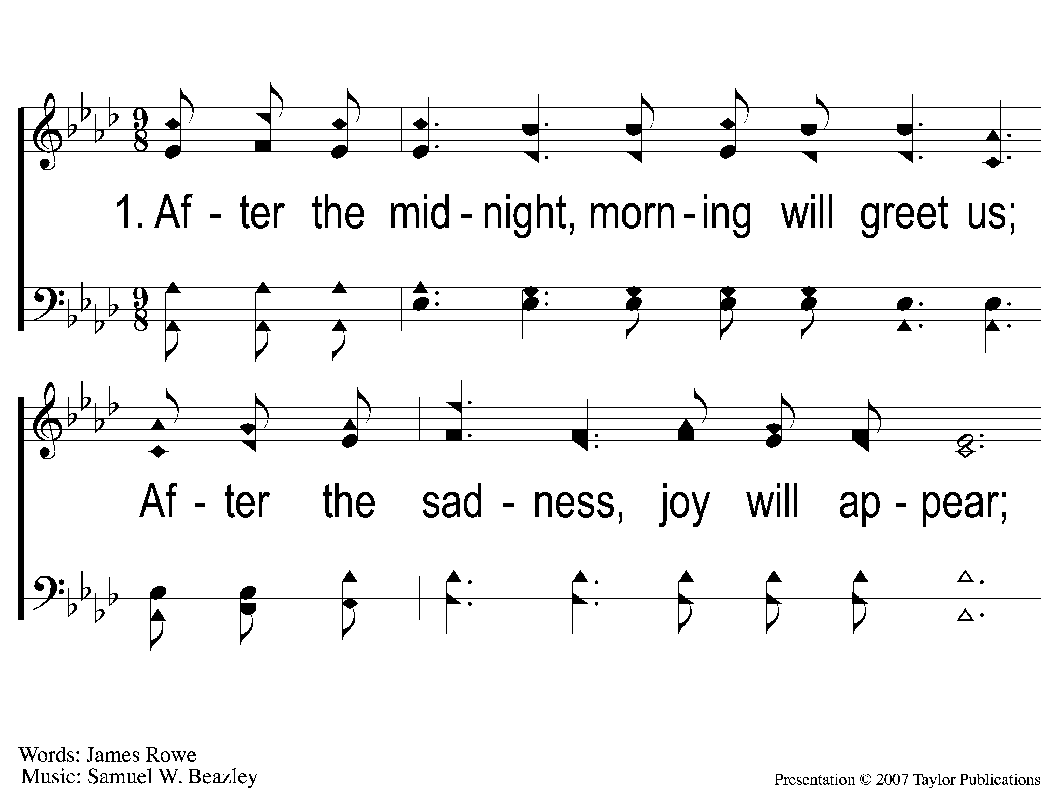
1-1 After the Midnight
After The Midnight
1

Slide 2
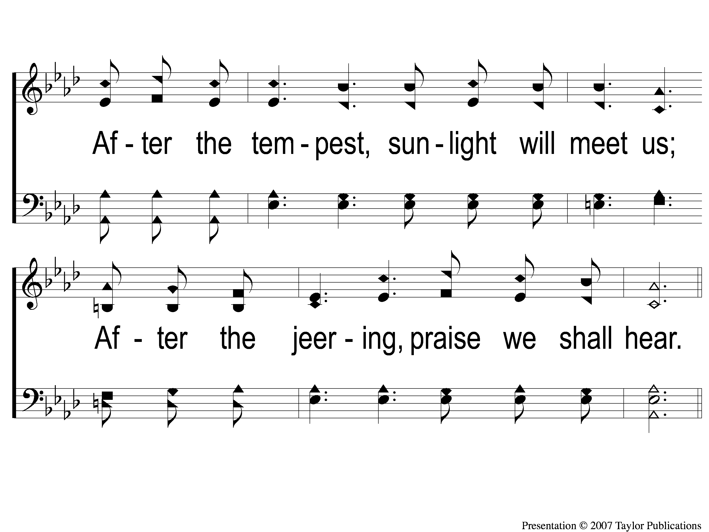
1-2 After the Midnight
After The Midnight
1

Slide 3
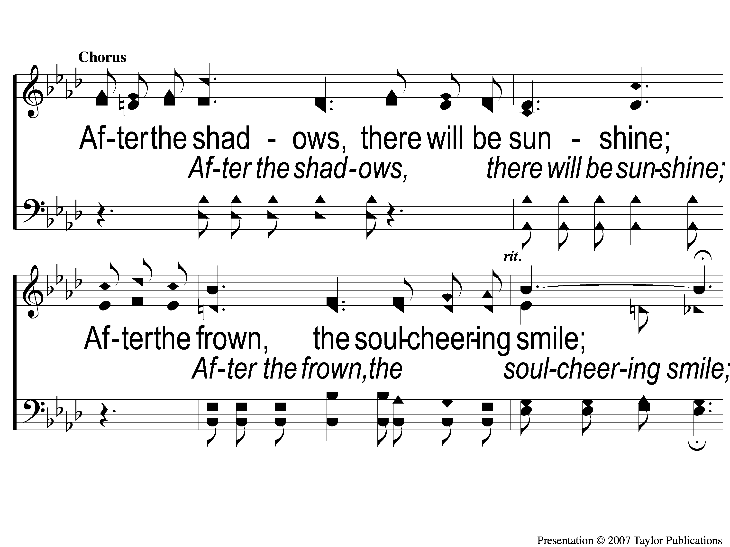
C-1 After the Midnight
After The Midnight
1

Slide 4
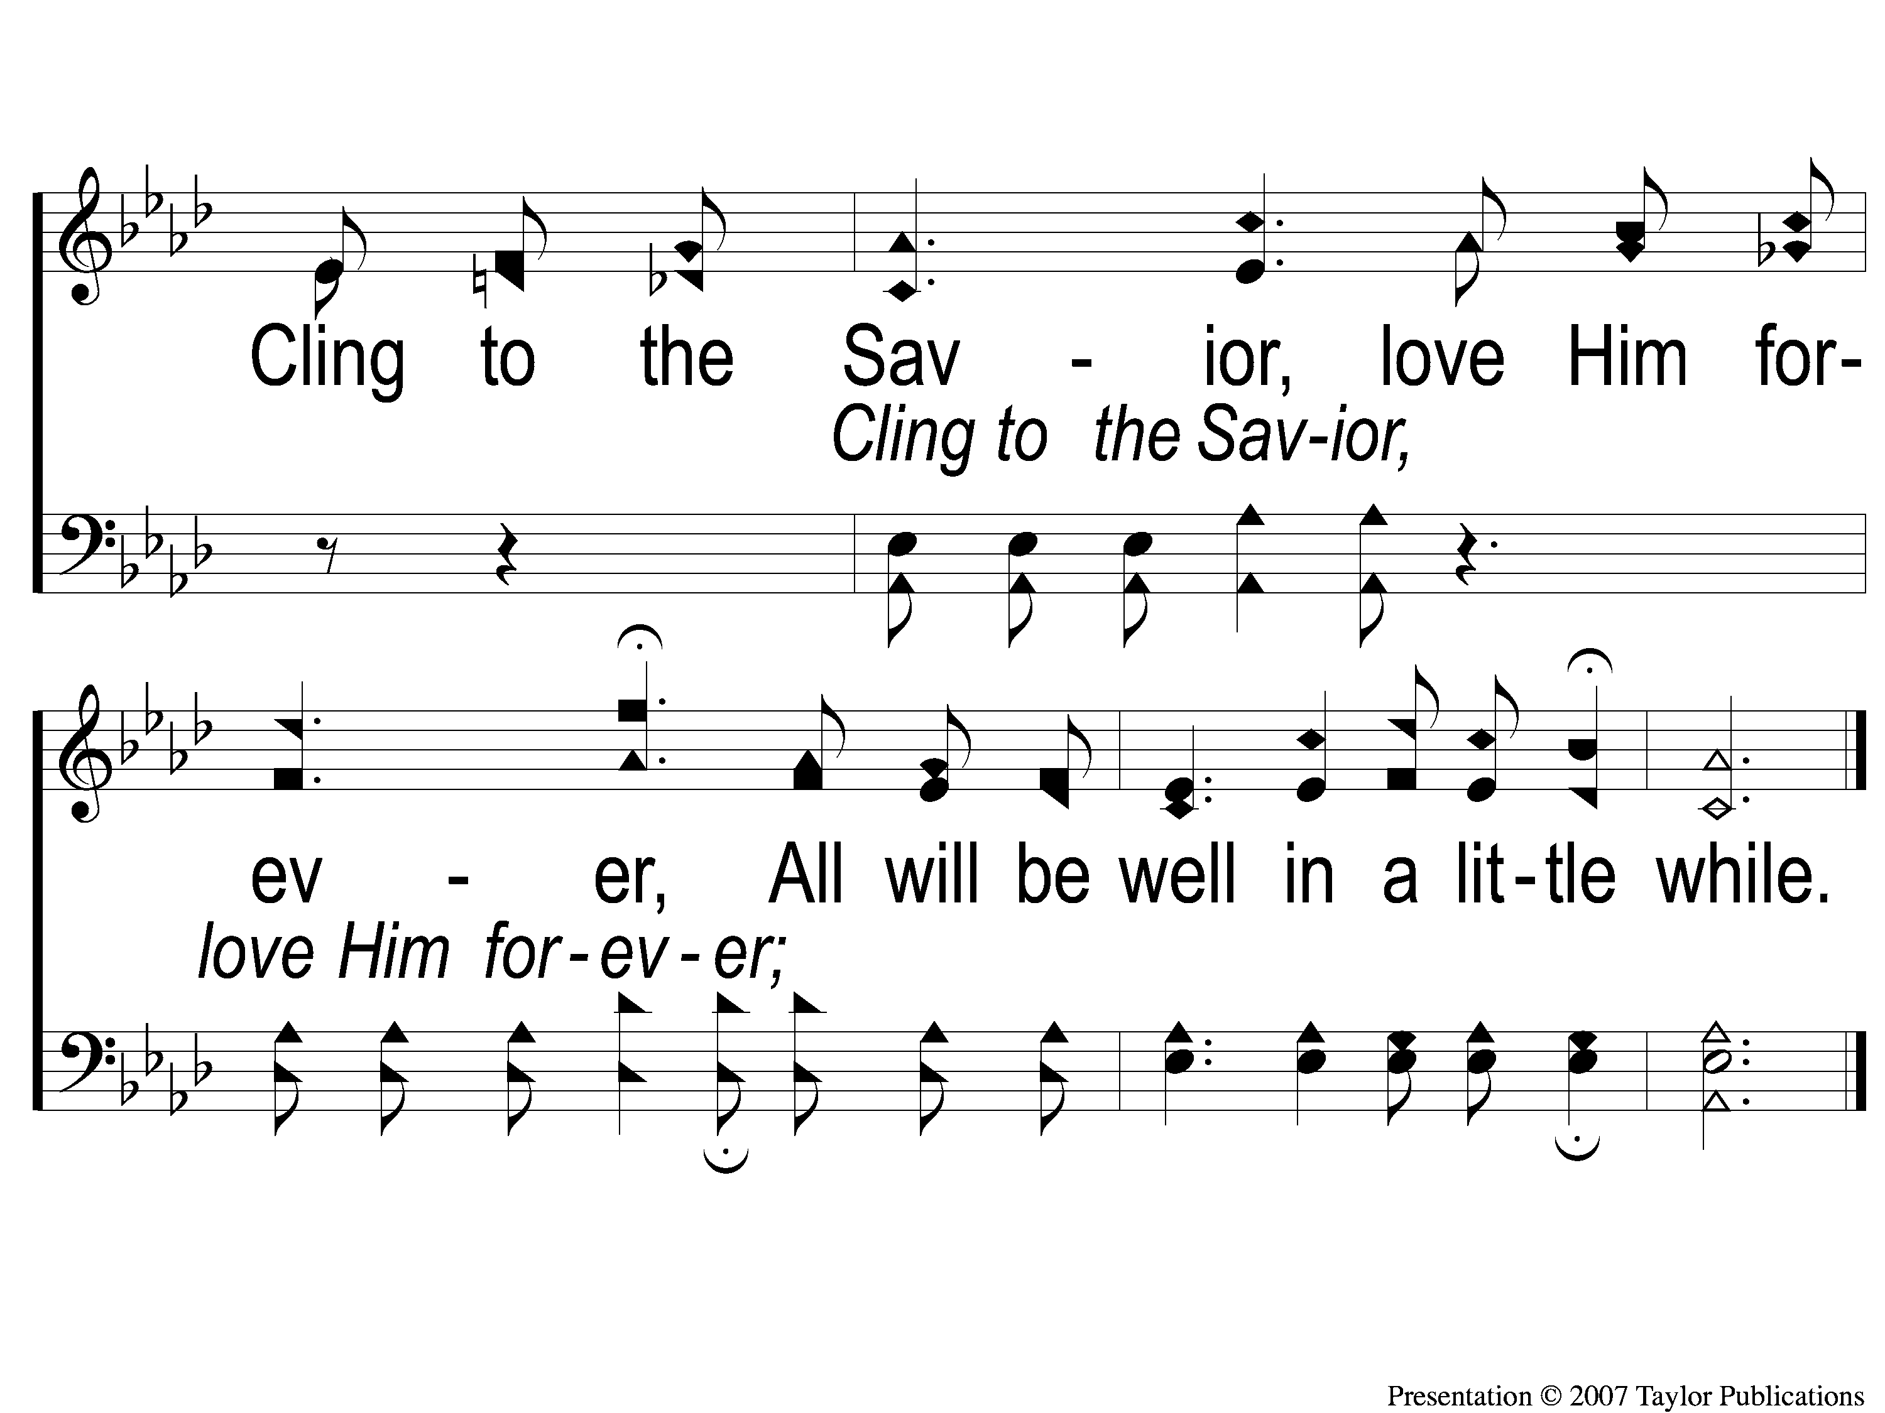
C-2 After the Midnight
After The Midnight
1

Slide 5
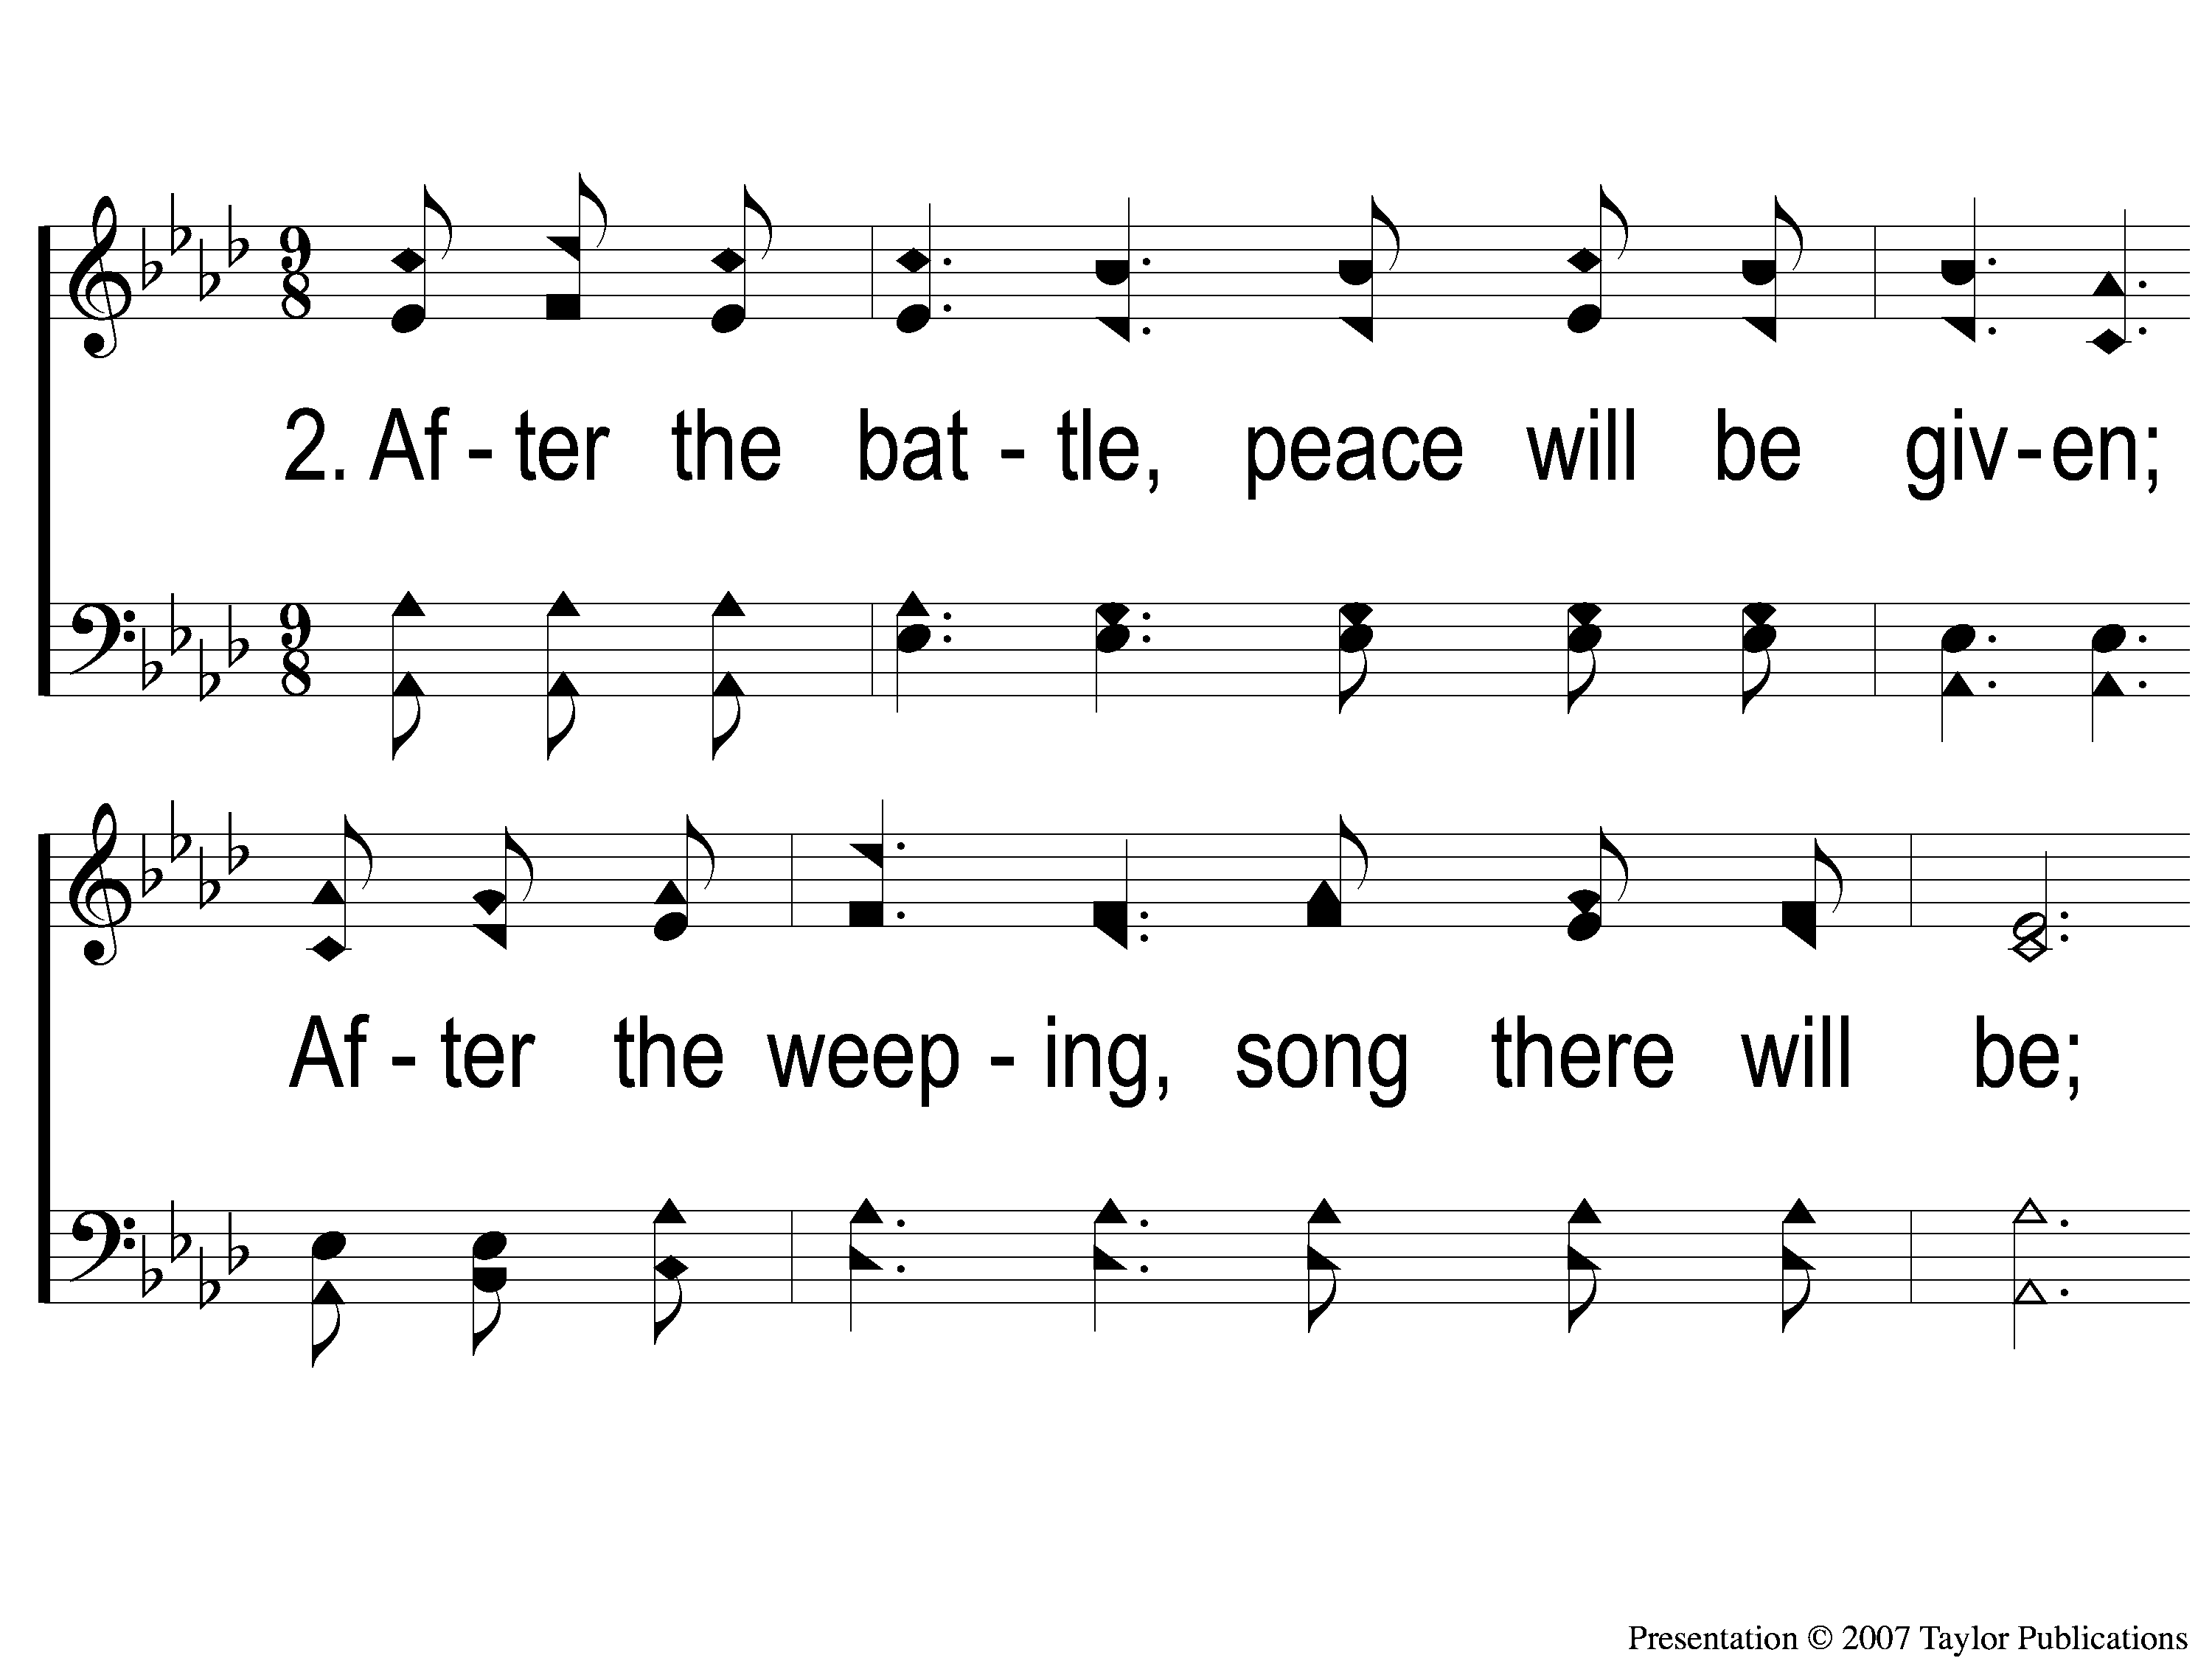
2-1 After the Midnight
After The Midnight
1

Slide 6
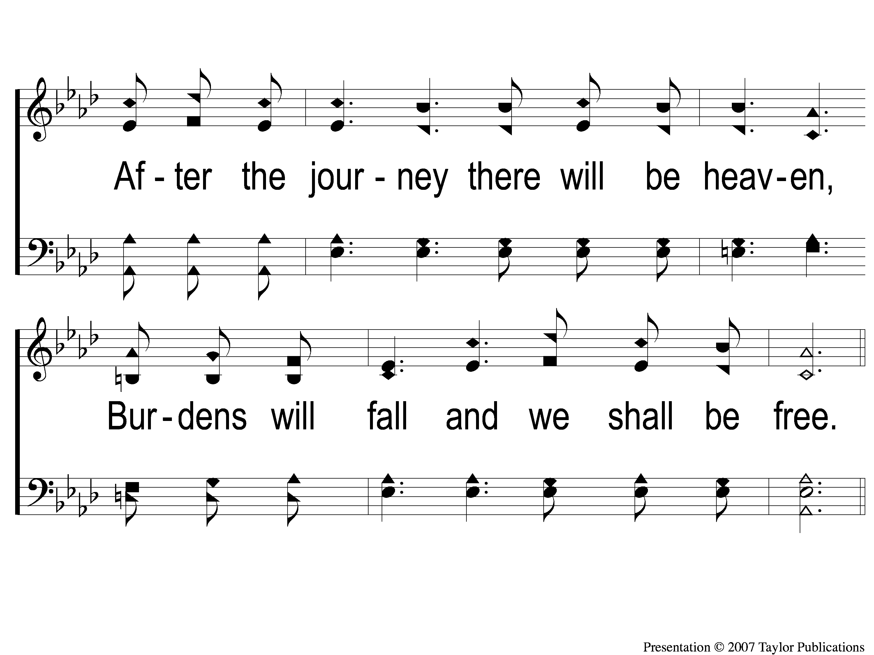
2-2 After the Midnight
After The Midnight
1

Slide 7
C-1 After the Midnight
After The Midnight
1

Slide 8
C-2 After the Midnight
After The Midnight
1

Slide 9
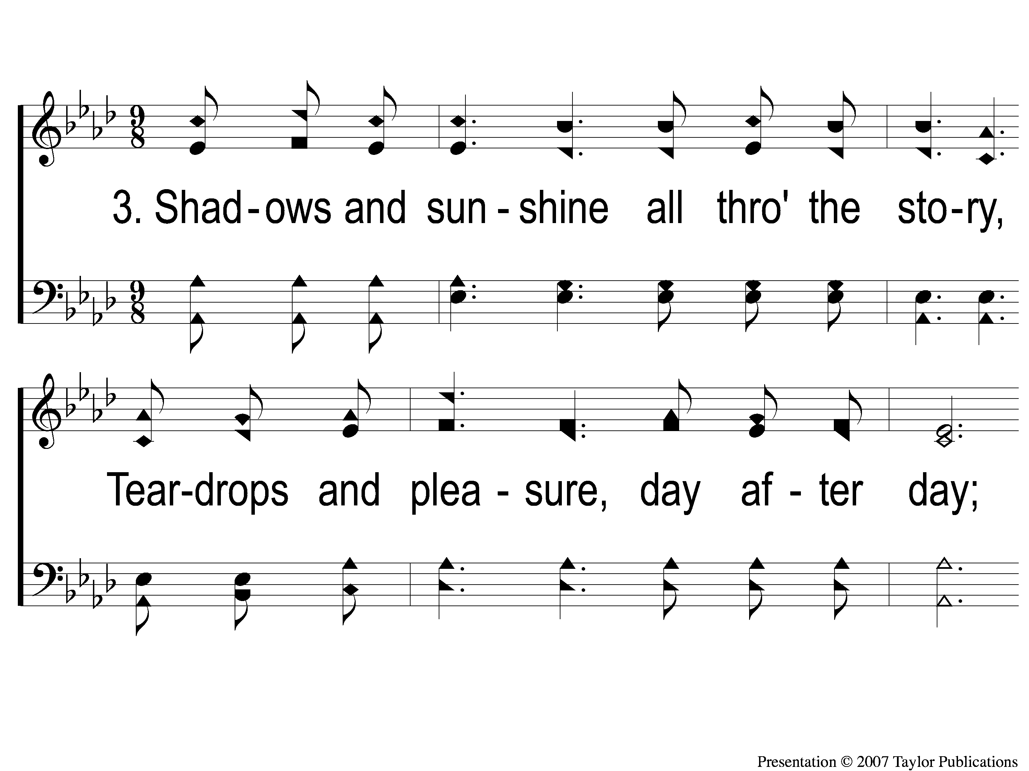
3-1 After the Midnight
After The Midnight
1

Slide 10
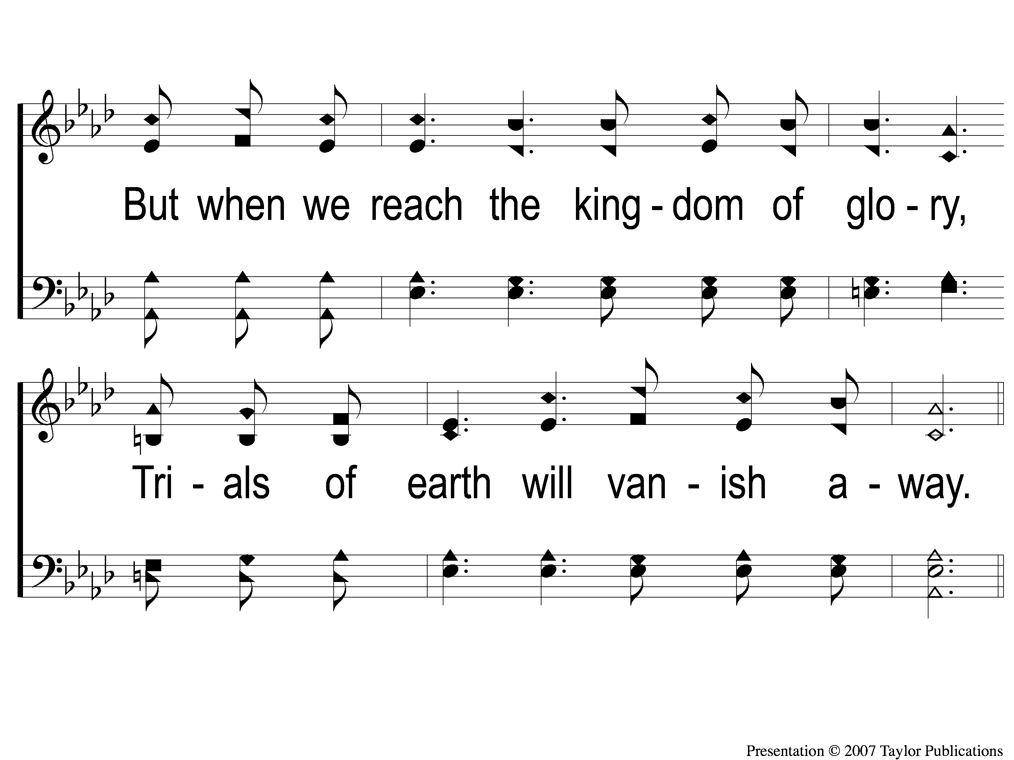
3-2 After the Midnight
After The Midnight
1

Slide 11
C-1 After the Midnight
After The Midnight
1

Slide 12
C-2 After the Midnight
After The Midnight
1

